Slide 1
Chapter 1 – Diversity of Life

Slide 2
1.1 Characteristics of Living Things
You should be able to:
■ list and define the characteristics of life.

Slide 3
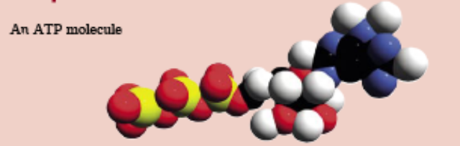
1.1 Characteristics of Living Things
All living things:
1. Grow
Growth in living things is the increase in size and number of cells. All organisms grow, change and become more complex in a process called development.
2. Respire
Living things require energy for several life processes such as metabolism and locomotion. Energy is stored in a chemical called Adenosine Triphosphate (ATP) during the process of respiration, where food is utilised.

Slide 4

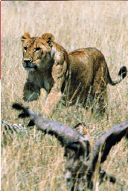
1.1 Characteristics of Living Things
All living things:
3. Display irritability
The ability of a living thing to respond to changes (stimulus) in the environment is called irritability.
4. Move
All living things are able to move on their own accord. Animals move to find food, shelter or in response to their environment. Plants are able to move parts of themselves towards light and water.

Slide 5
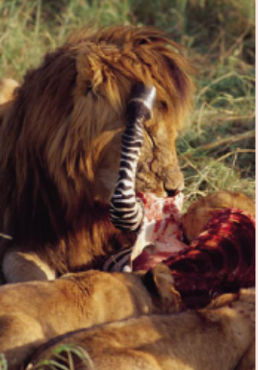
1.1 Characteristics of Living Things
All living things:
5. Require nutrition
Nutrients are required by all living things to obtain energy and build new protoplasm. Plants obtain nutrients from photosynthesis, while animals obtain nutrients by eating other plants and animals.
6. Excrete
Excretion – process of removing metabolic waste products from living things.
The importance of excretion – ensure homeostasis as the accumulation of such waste products can be toxic and harmful to the organism.

Slide 6
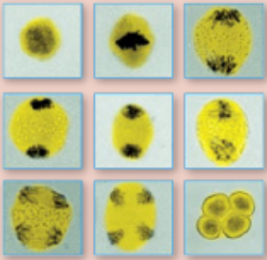
1.1 Characteristics of Living Things
All living things:
7. Reproduce
All living things can produce new individuals, thus ensuring the continuation of the species.
Genetic material found in the nucleus of cells in the form of DNA, is replicated and passed down from parent to their offspring.
It determines the organism’s characteristics and so the characteristics of the parent are passed on to the offspring.
A plant cell reproduces by mitosis

Slide 7
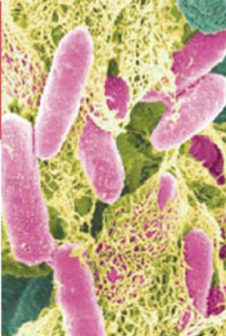
1.1 Characteristics of Living Things
All living things:
8. Are made up of cells
Cells are the basic unit of life.
Unicellular organisms are composed of only one cell.
E.g. Bacteria (Escherichia coli)
Multicellular organisms are composed of many cells.
E.g. Humans
In multicellular organisms, cells are grouped into different levels of organisation from tissues to organ systems.

Slide 8
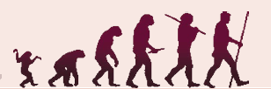
1.1 Characteristics of Living Things
All living things:
9. Adapt and evolve
Adaptations are modifications enabling an organism to survive in an environment.
These adaptations come about through evolution, the process by which a species changes through time.

Slide 9
1.1 Characteristics of Living Things
All living things:
10. Maintain homeostasis
To remain alive, all living things maintain a constant internal environment despite changes in the external environment (homeostasis).
An example is excretion in humans, where waste products formed during metabolic reactions are removed from the body.
All organ systems are involved with homeostasis.

Slide 10
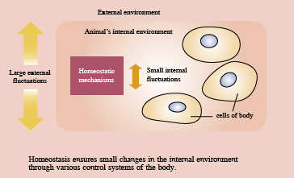

Slide 11
1.2 Classification of Living Things
You should be able to:
■ describe the major groups of organisms;
■ understand how a classification system is used to group living things; and
■ group living organisms according to observed similarities and differences.

Slide 12
1.2 Classification of Living Things
Defining a species
A species is the basic unit of classification. Members of a single species have the following features:
• A common ancestry – they originated from an existing species.
• Very similar genes and therefore have similar physical, biochemical and behavioral features
• Fertile organisms and can interbreed to produce fertile offspring.

Slide 13
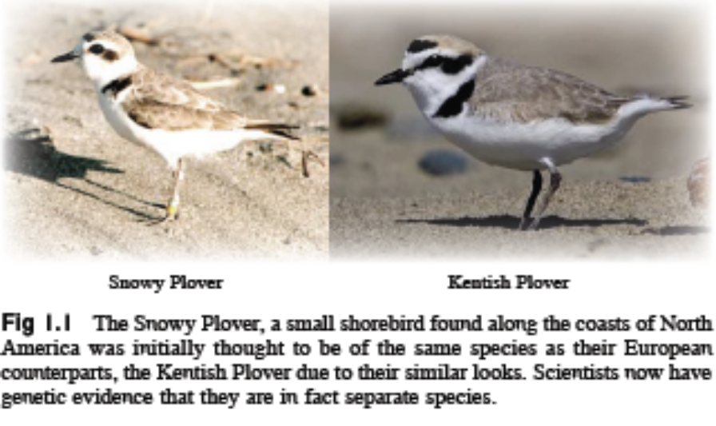
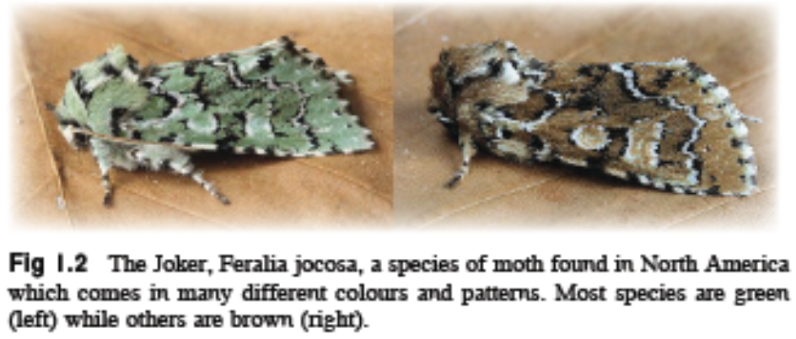
Species change and evolve over time. Hence, physical appearance is not a reliable tool to distinguish different species as different species can look very similar in some instances!

Slide 14
1.2 Classification of Living Things
Classifying species
Classification is the sorting of things into groups.
With more than 2 million different species of living things in the world, and as new species are being discovered everyday, a classification system is necessary to make sense of it all.
Grouping living things based on their similarities provides a better understanding of their lives, patterns, behaviours, environment and evolution.

Slide 15
1.2 Classification of Living Things
Classifying species
There are two basic methods to classify living things:
• Artificial classification uses observable characteristics (e.g. colour, size, shape or number of legs) to classify organisms.
It is a convenient and easy way of classification without taking into account the evolutionary origins of the organism.
E.g. butterflies and birds both use their wings for flight but they originated in different ways.

Slide 16
1.2 Classification of Living Things
Classifying species
Natural classification is where organisms are grouped based on shared features from their ancestors and reflect their evolutionary descent.
(more widely used in biology)
It is structured as a hierarchy where organisms are classified into large groups, which are then subdivided into smaller groups.
Each group is called a taxon (plural: taxa).

Slide 17
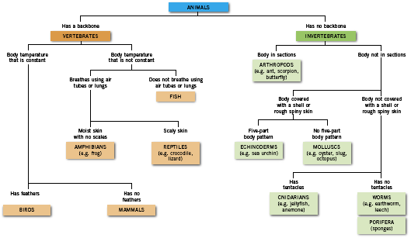
1.2 Classification of Living Things
Fig 1.4: Classification of the main groups of animals

Slide 18
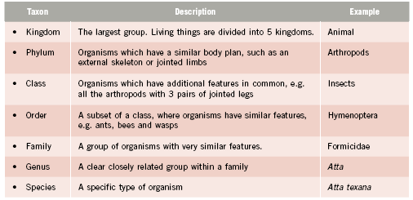
1.2 Classification of Living Things
The taxonomic hierarchy used to classify organisms is shown in the table below:

Slide 19
1.2 Classification of Living Things
Naming species
Biologists follow the binomial system created by Linnaeus.
Organisms are identified by two names, the genus and species name.
The names are often based on Latin or Greek and is used and understood by scientists all over the world.

Slide 20
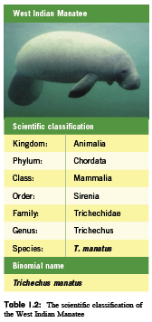
1.2 Classification of Living Things
The binomial name of the West Indian Manatee is Trichechus manatus.
This is similar to the given name of a person, and is not shared by the other species of the same genus.
Notice that a binomial name starts with a capital letter but the species name does not.

Slide 21
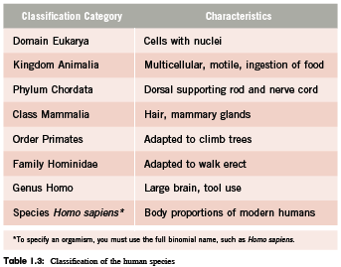
1.2 Classification of Living Things
Another example for the classification of the human species is shown below:

Slide 22
1.2 Classification of Living Things
The five kingdoms
All living organisms belong to one of the five kingdoms.
Organisms belonging to Kingdom Protoctista, Fungi, Plantae and Animalia are eukaryotic.
Eukaryotes – Organisms whose cells contain a nucleus and membrane-bound organelles
The fifth kingdom is Prokaryotae which includes all the bacteria.
Prokaryotes – Organisms whose cells do not contain distinct nucleus or membrane-bound organelles

Slide 23
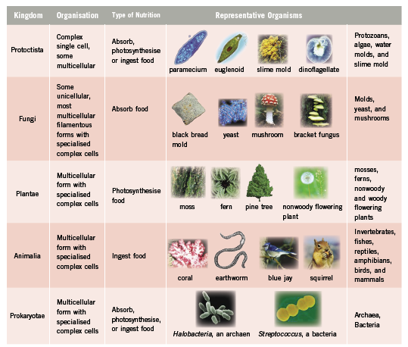
1.2 Classification of Living Things
Table 1.3: A summary of features of the five kingdoms

Slide 24
1.2 Classification of Living Things
Table 1.3: A summary of features of the five kingdoms

Slide 25
Key Concepts
Characteristics of life
All living things reproduce, grow, consist of cells, adapt and evolve, require energy, respond to stimuli and maintain homeostasis.
These characteristics ensure the continuation of a species and its survival.

Slide 26
Key Concepts
Classification of living things
Taxonomy is the study of biological classification.
A species is a group of organisms with common ancestry and very similar genes. They are fertile organisms which can interbreed to produce fertile offspring.
Living organisms can be grouped based on shared features from their ancestors and reflect their evolutionary descent. This is structured as a hierarchy where organisms are classified into large groups, which are then subdivided into smaller groups. Each group is called a taxa.

Slide 27
Key Concepts
Classification of living things
Organisms are grouped into different levels in a definite order: Kingdom → Phylum → Class → Order → Family → Genus → Species
Organisms are identified by two names, the genus and species name.
There are five kingdoms which include all living organisms. Kingdom Protoctista, Fungi, Plantae and Animalia are eukaryotes. The fifth kingdom is Prokaryotae which includes all the bacteria.
Eukaryotic cells have a distinct nucleus and membrane-bound organelles while prokaryotic cells do not.

